Slide 1
Modeling a Communication System in MATLAB
Adam Chapman and Ryan Gill

Slide 2
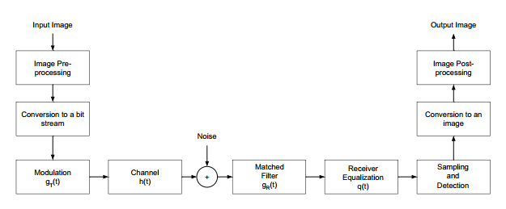
System Overview

Slide 3
HSP Response

Slide 4
SRRC Response

Slide 5
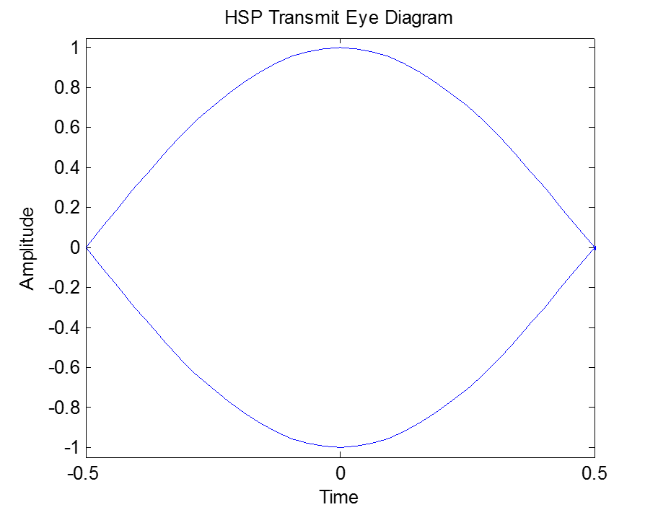
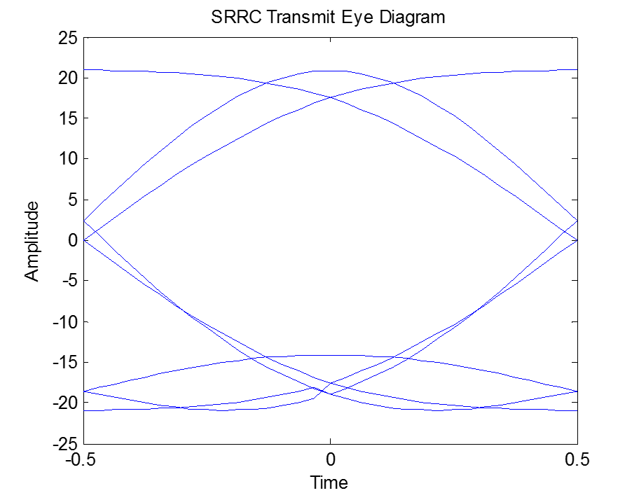
Transmission Eye Diagrams

Slide 6
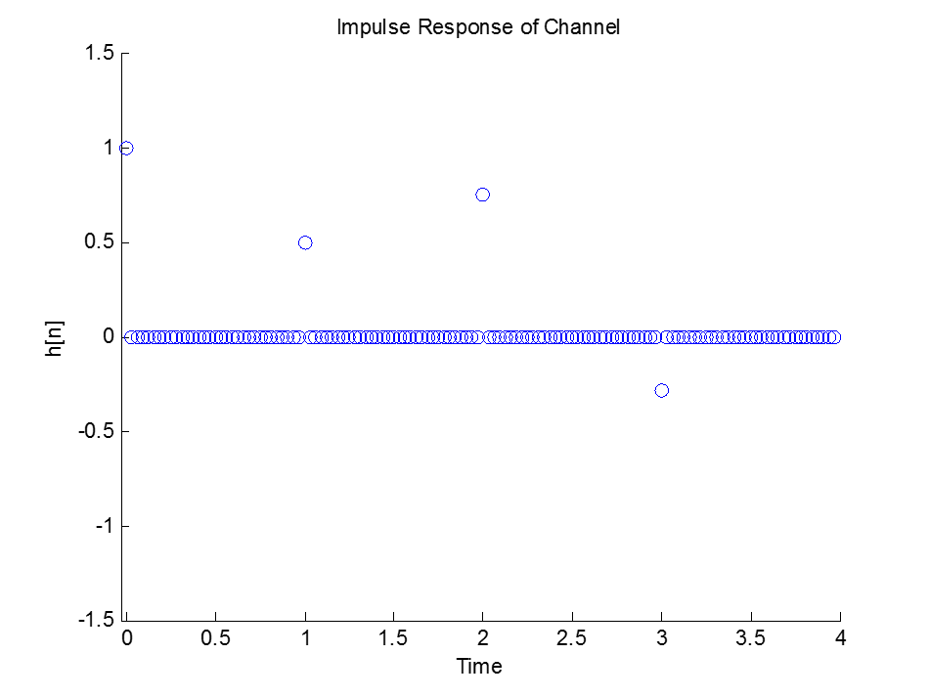
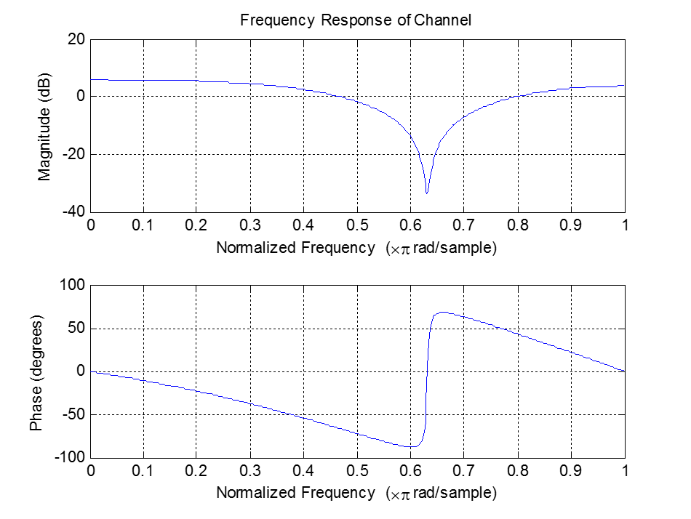
Responses of Channel

Slide 7
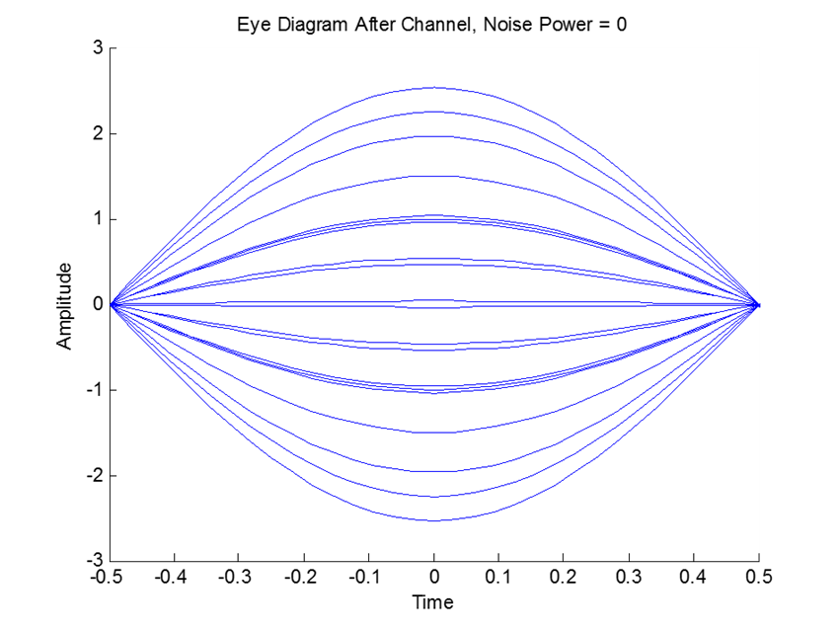
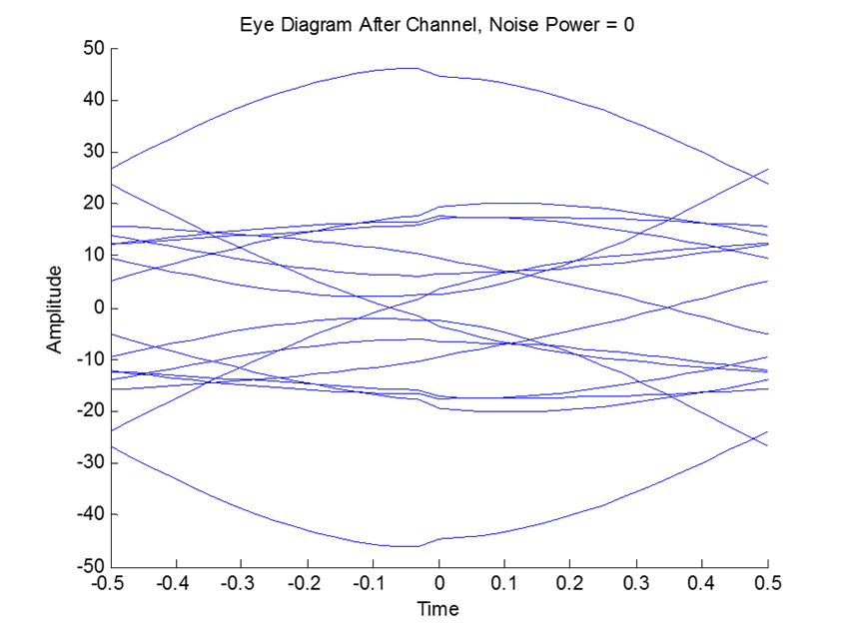
Eye Diagrams After Channel
Half Sine Pulse
Square Root Raised Cosine

Slide 8
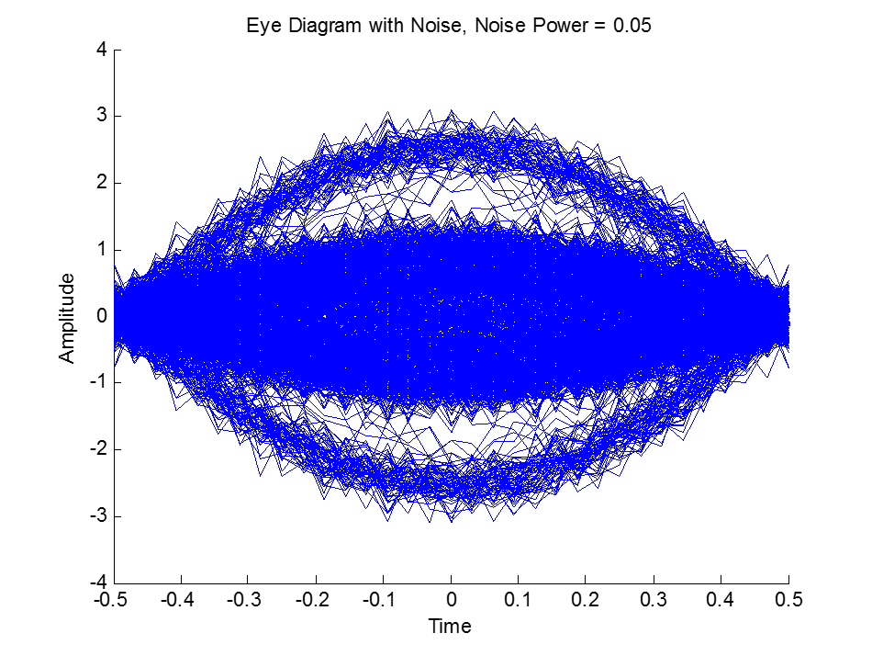
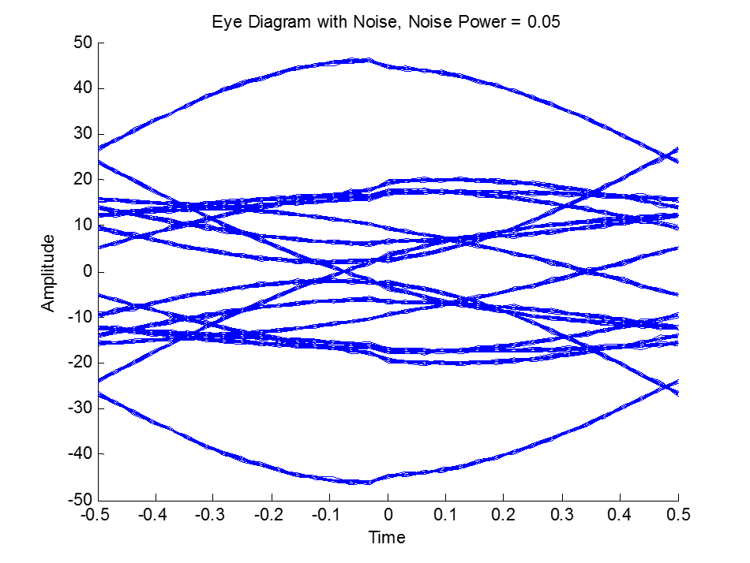
Eye Diagrams After Channel with Noise
Half Sine Pulse
Square Root Raised Cosine

Slide 9
HSP Matched Filter Response

Slide 10
SRRC Matched Filter Response

Slide 11
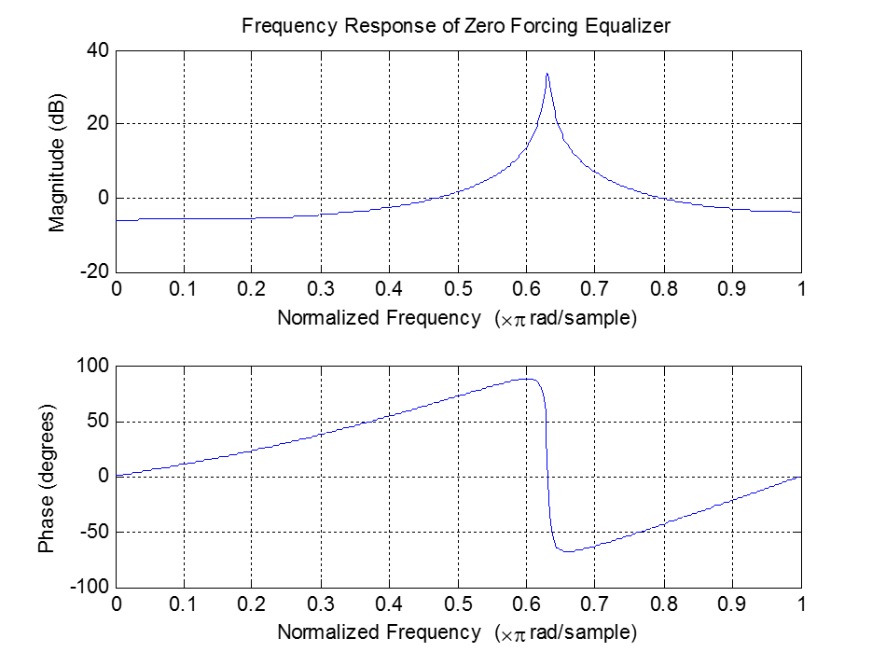
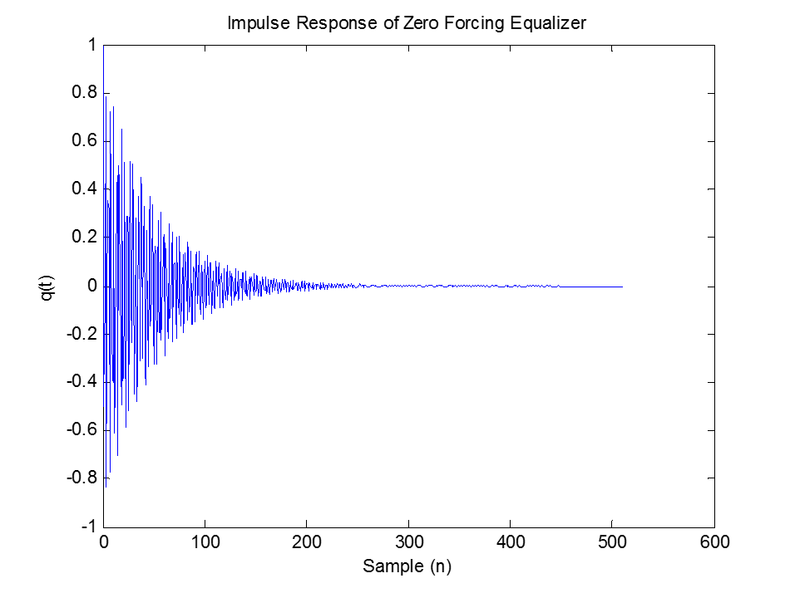
Response of Zero Forcing Equalizer

Slide 12
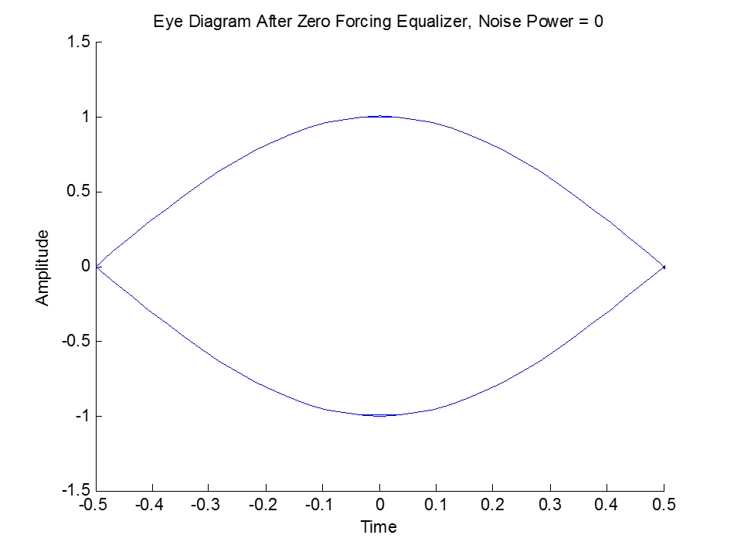
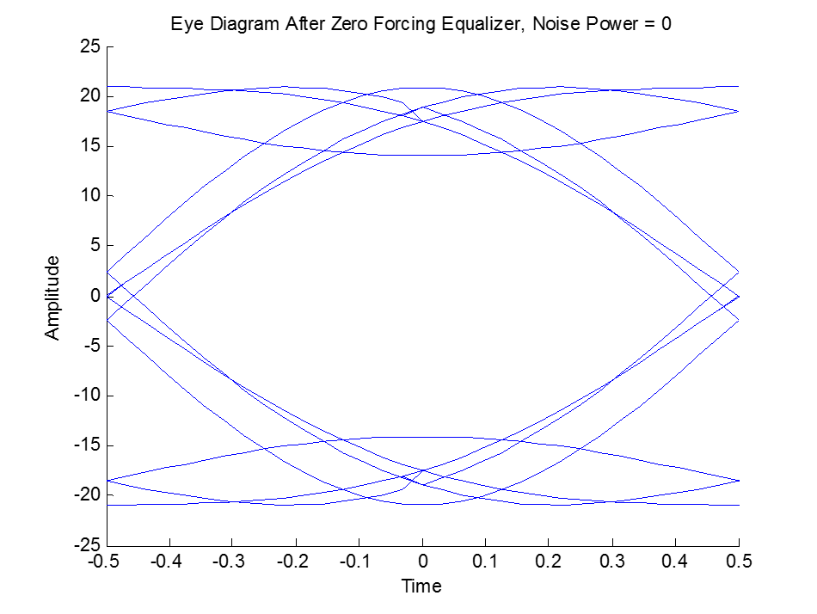
Eye Diagrams After ZF Equalizer
Half Sine Pulse
Square Root Raised Cosine

Slide 13
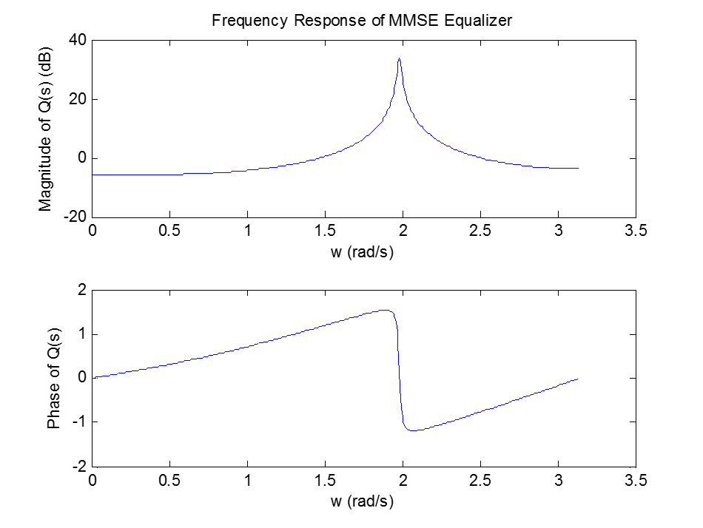
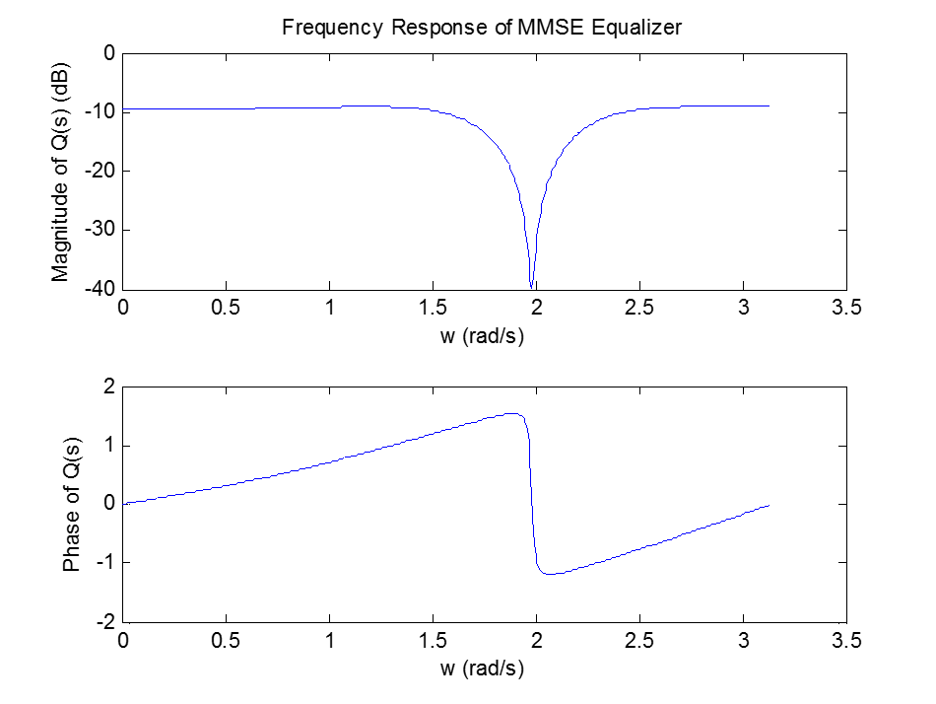
Frequency Response of MMSE Equalizer
Noise Power = 0
Noise Power = 1

Slide 14
Impulse Response of MMSE Equalizer

Slide 15
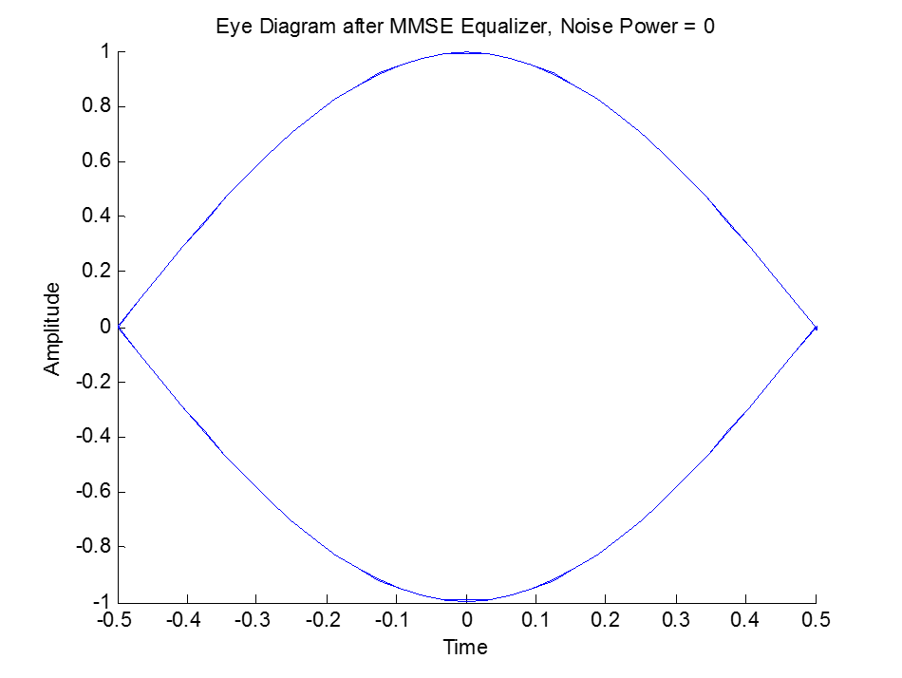
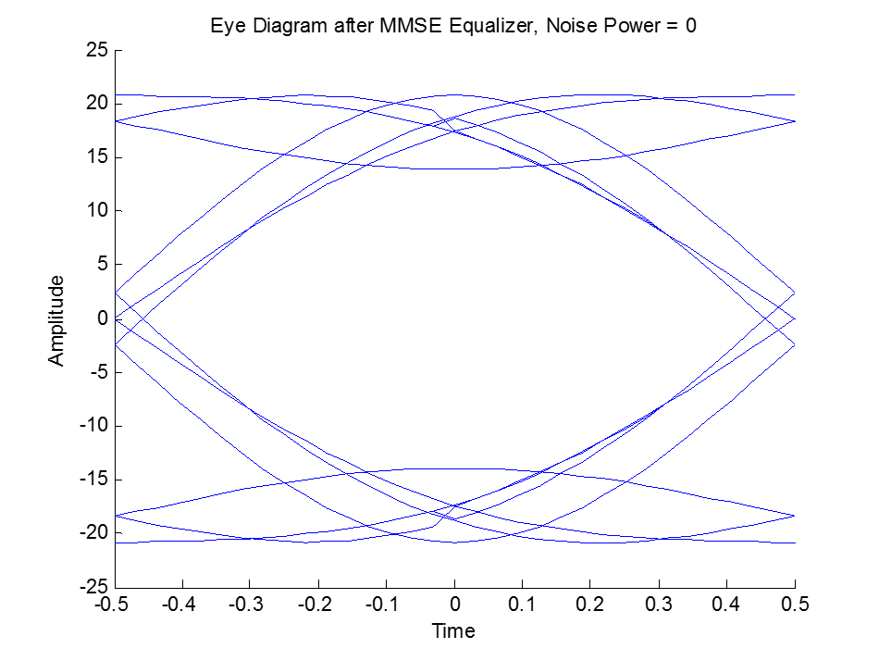
Eye Diagrams After MMSE Equalizer
Half Sine Pulse
Square Root Raised Cosine

Slide 16
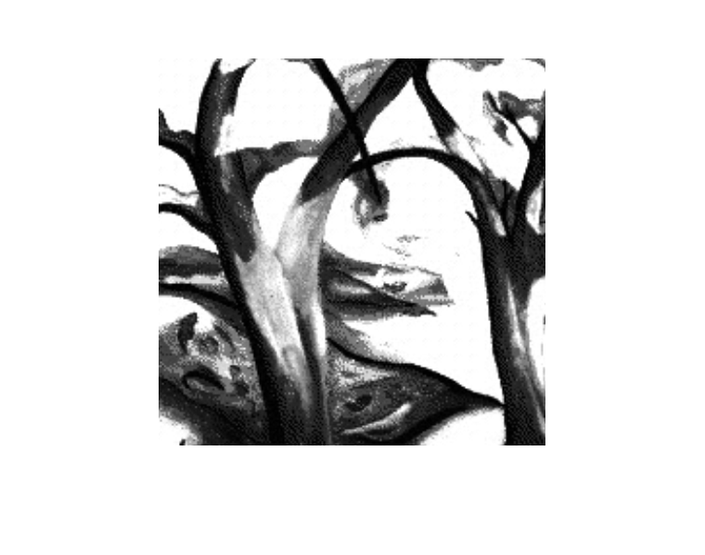

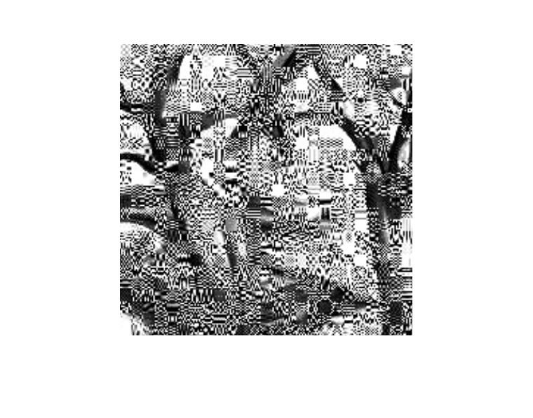
Recovered Images (ZF Equalizer)
0 Noise
0.1 Noise
1 Noise
HSP
0 Noise
50 Noise
100 Noise
SRRC

Slide 17
HSP, Noise Power = 0.1
Zero Forcing
MMSE

Slide 18
Transmitting HSP

Slide 19
Transmitting HSP

Slide 20
Questions?

